Slide 1

Introduction to the course
Decision Modeling in R workshop

Slide 2

Instructors
Alexandra Moskalewicz
David Ulises Garibay-Trevino
Eline Krijkamp
Petros Pechlivanoglou
Special thank you to Navpreet Kaur

Slide 3
The DARTH Workgroup
Materials for this course were largely developed by the Decision Analysis in R for Technologies in Health (DARTH) Workgroup
Goals: To expand knowledge in decision analysis using R and develop educational materials to empower people to construct R-based decision models.
For more information
http://www.darthworkgroup.com/

Slide 4

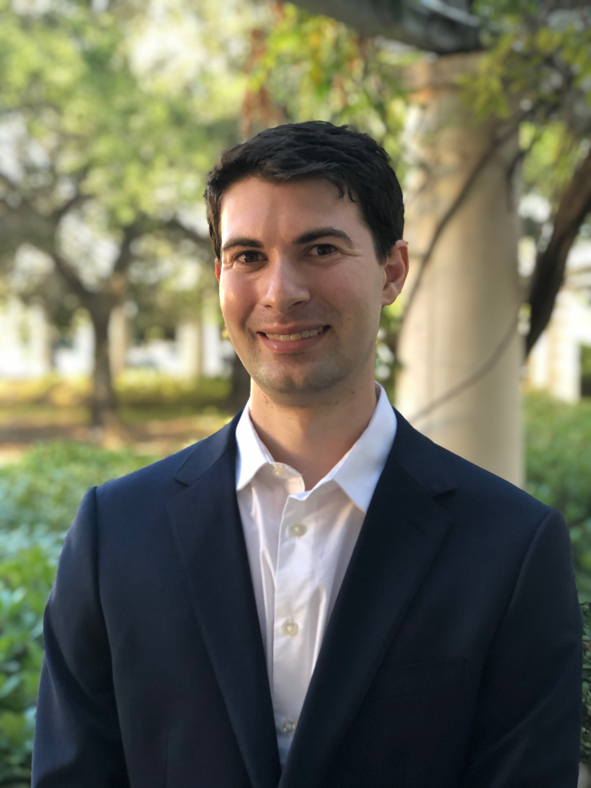

Slide 5
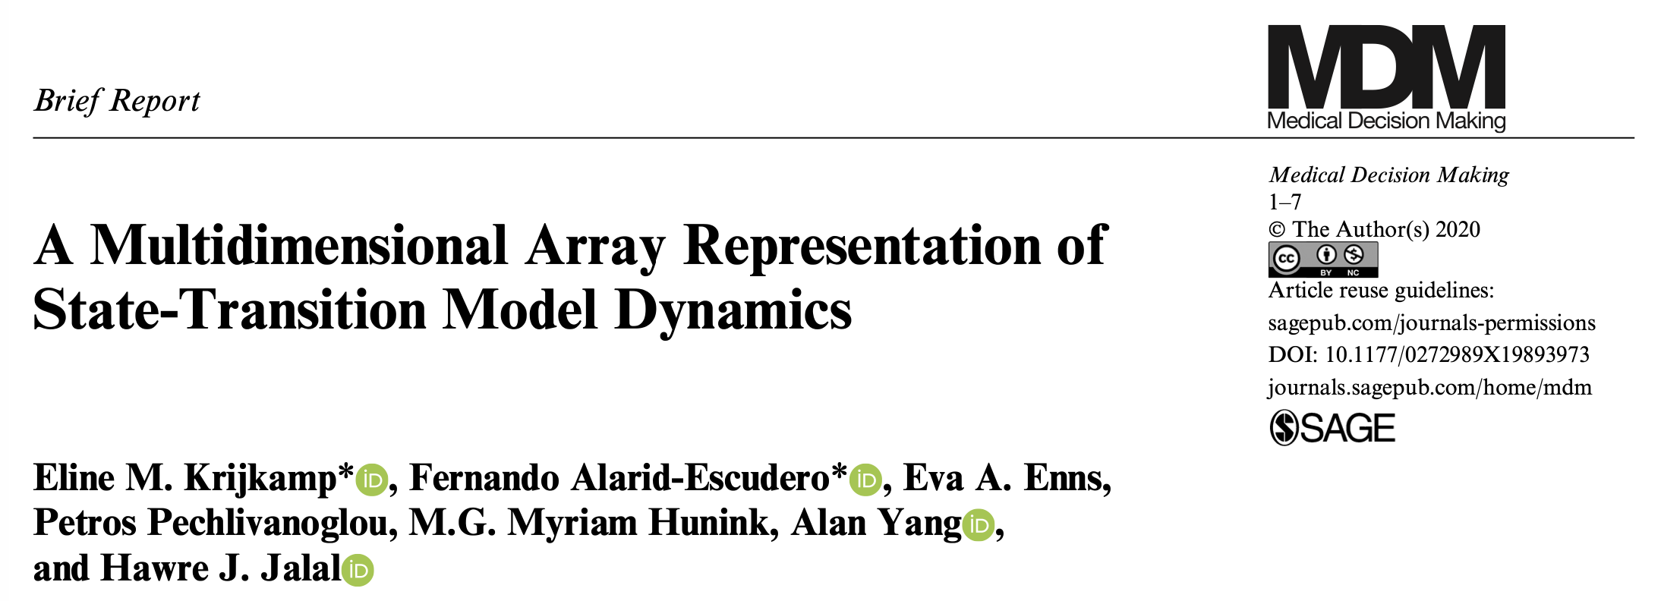
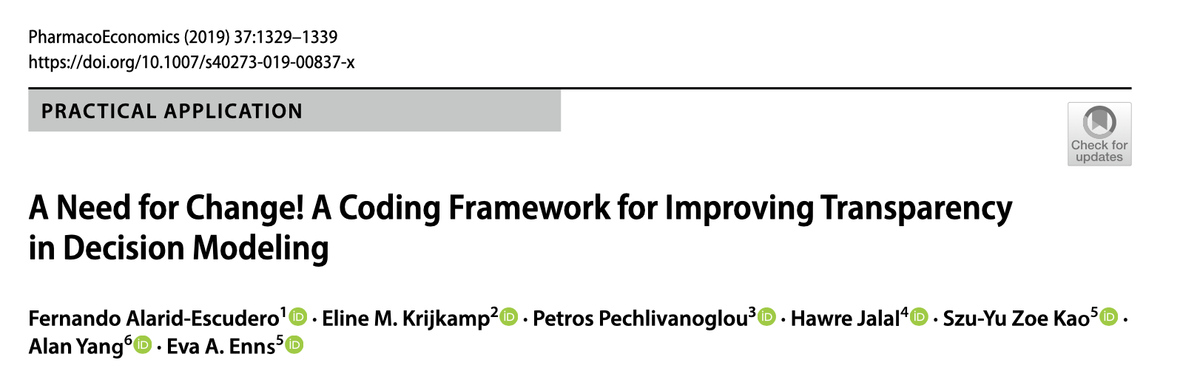
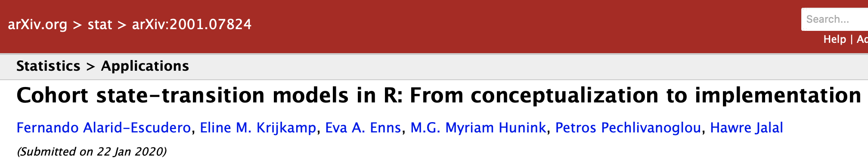
DARTH Publications

Slide 6
This course
Notes:
Before we move on to the basics of R for decision sciences - questions?
This next section will be a live coding section, we encourage you to follow allong
Introduction to R outline
9.00am - 9.15am Breakfast - meet and greet
9.15 am - 10.00am Introduction to R: An overview
Graphical Interface
Getting help
Libraries
Simple operations
10.00am - 10.45am Mathematics and statistics in R
Assigning values
Elements vectors and matrices
Vector and matrix operations
Distributions
10.45am - 11.00am Coffee break
11.00am - 12.00pm Data manipulation and data handling
Data input output
Data selection
Replacing data
Converting variables with logical expressions
12.00pm - 1.00pm Lunch Break
1.00pm - 1.45pm Plotting in R
Scatterplots
Bar Plots
Histograms
The ggplot package
1.45pm - 2.30pm Exercise I & Discussion
2.30 pm - 2.45pm Coffee Break
2.45pm - 3.15pm Statistical analysis in R
Mean, variance, correlations
Linear (multiple) regression
Regression diagnostics
Exercise II & Discussion
3.15pm - 4.15pm Advanced data handling in R
The dplyr package
4.15pm - 5.00pm Logical expressions and random sampling in R
Logical expressions
Iterative processes
Vectorization
Random sampling in R
Exercise III & Discussion

Slide 7
Practical
Room every day same
Exit
Washrooms
Microphone use
Lunch
Partner with buddy

Slide 8
Logistics – Course Website

Slide 9
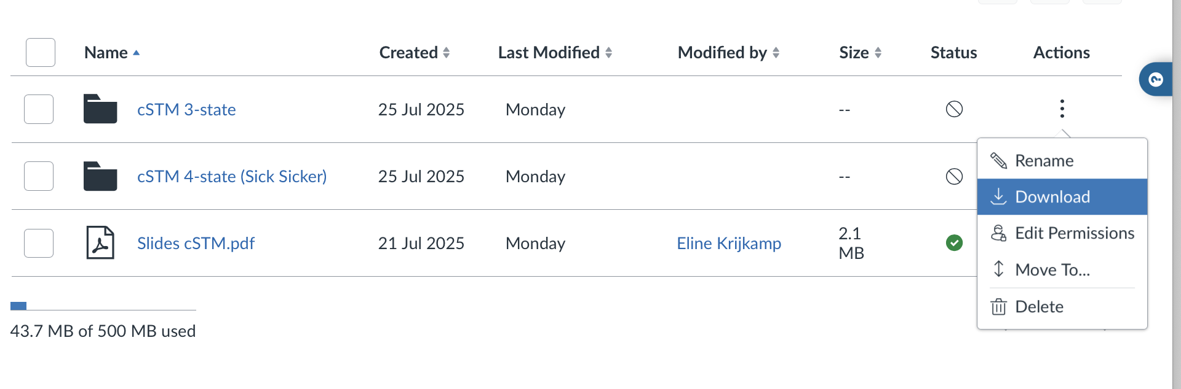
Demo
Exercise
Download full folder
Windows: unzip before your

Slide 10
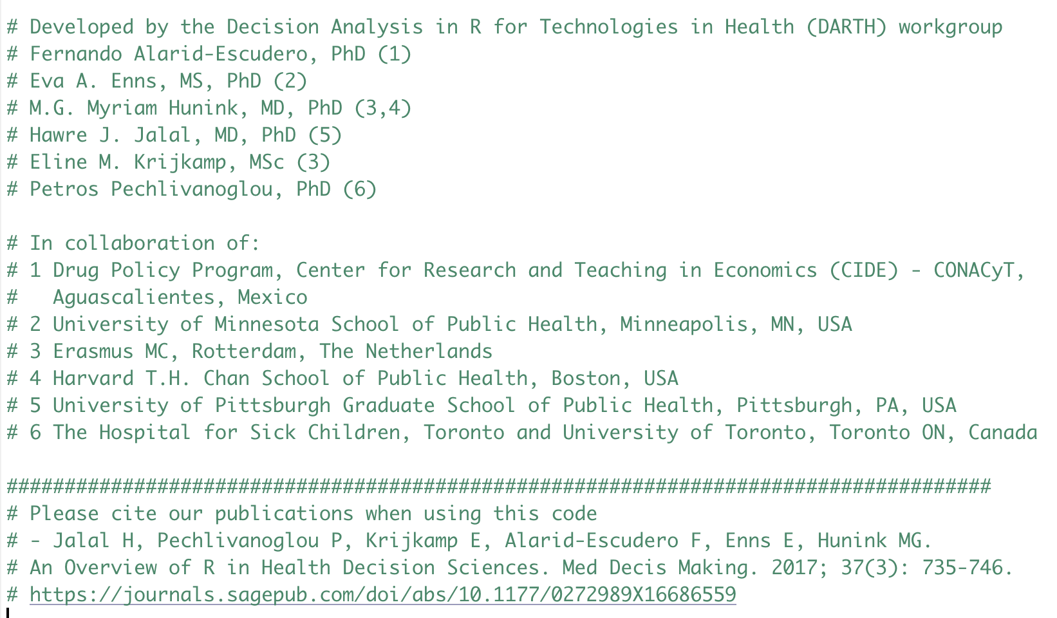
Attribution and Acknowledgement
R code provided with this course are yours to reuse and modify
Acknowledgement and citation information in code headers

Slide 11


Slide 12

In-class
Make groups of 3
Use the cards
Ask the question.

Slide 13
Why R?
Freely available and open-source
Flexibility to implement any desired modeling structure
  Computationally efficient
Results are reproducible
  no “point-and-click” steps
Integrate statistical analyses with modeling
  Parameter estimation
  Analysis / visualization of results

Slide 14
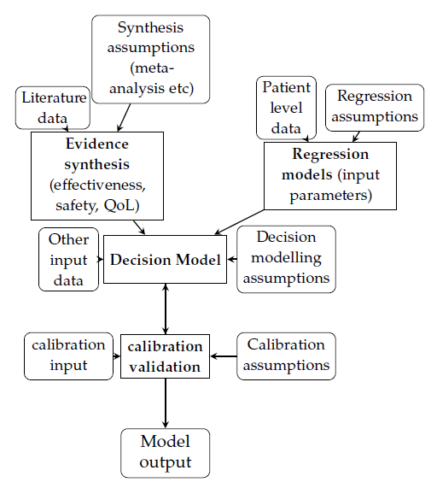







Conventional Decision Modeling Process
Notes:
Three main approaches
Specialized decision modeling software
TreeAge, Data, Crystal8, Arena etc.
Spreadsheet software
Microsoft Excel, Open/Libre Office
Statistical/ Computer programing software
Matlab, R, C++, Python, WinBUGS, etc

Slide 15
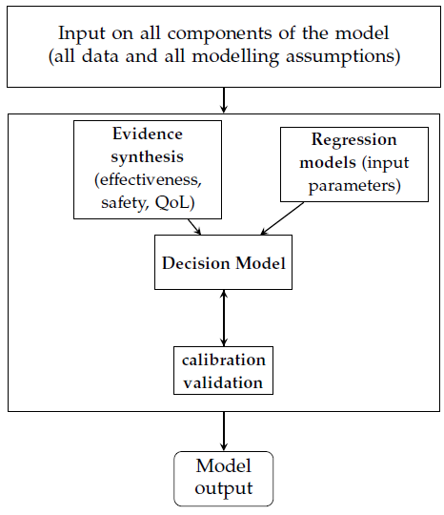
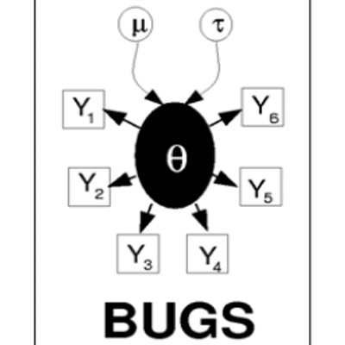

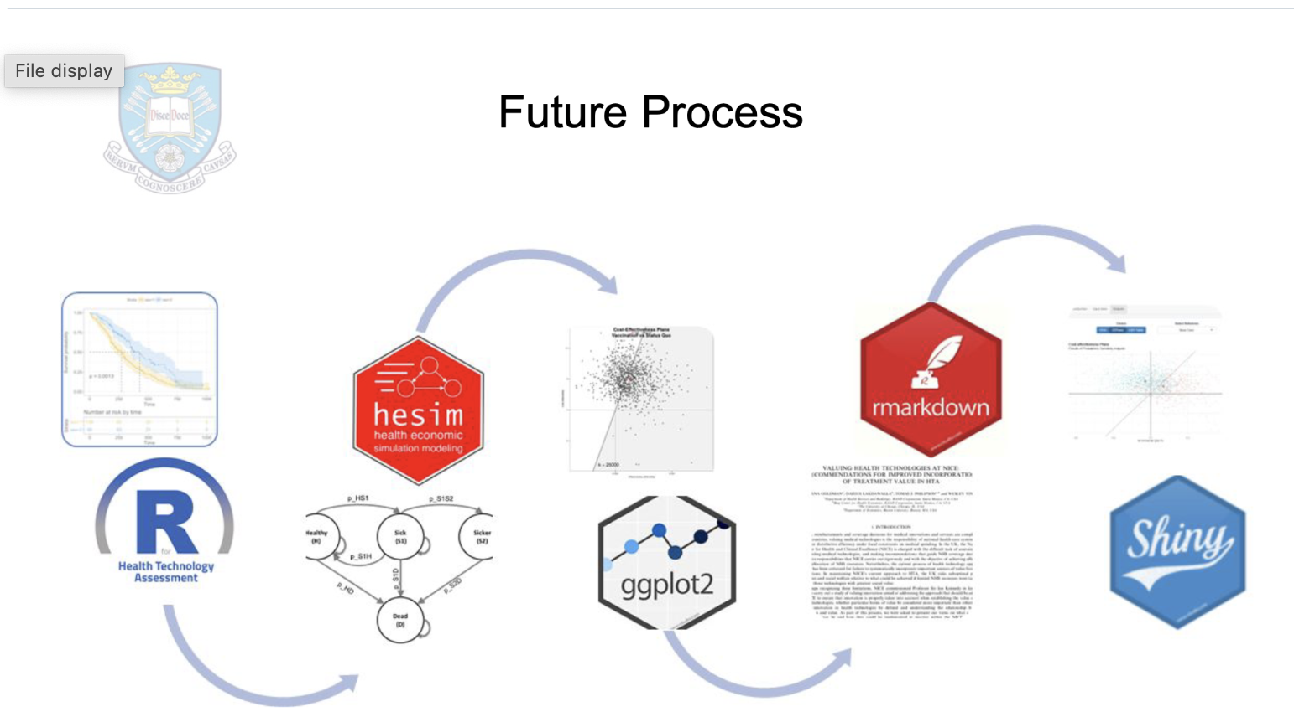
Streamlining Decision Modeling

Slide 16

The growing role of R in HTA research
Early barriers
Steep learning curve
Lack of guideline endorsement for R-based analyses
Recent shifts
Increasing guideline acceptance of R-based models
Broader adoption due to trend in open science¹
Expansion of R packages and educational materials (e.g dampack, hesim, R for HTA book)²
Artificial intelligence help (e.g. copilot )
1. Raymond H. Henderson et al., Mapping the Landscape of Open Source Health Economic Models: A Systematic Database Review and Analysis: An ISPOR Special Interest Group Report,
Value in Health, Volume 28, Issue 6, 2025
2. among others, Book R for Health Technology Assessment, DARTH, darkpeak analytics, R for HTA, several package on Github and Cran

Slide 17
Broad modeling methods categories (non-exhaustive)
Evaluate trade-offs
Recurring events
Balance sheet
Discete time
Cohort based
Individual-level based
State-transition models
cSTM
Markov model
iSTM/
Microsimulation
Decision tree
Partition survival model
Continuos time
Discrete event simulations
Notes:
Modeling recurreing events
events of time, ongoing risk over time, competing risk, prognosis

Slide 18

Broad modeling methods categories (non-exhaustive)
Infectious disease models and more
Evaluate trade-offs
Recurring events
Balance sheet
Discete time
Cohort based
Individual-level based
State-transition models
cSTM
Markov model
iSTM/
Microsimulation
Decision tree
Partition survival model
Continuos time
Discrete event simulations
Notes:
Modeling recurreing events
events of time, ongoing risk over time, competing risk, prognosis

Slide 19
Broad modeling methods categories (non-exhaustive)
Evaluate trade-offs
Recurring events
Balance sheet
Discete time
Cohort based
Individual-level based
State-transition models
cSTM
Markov model
iSTM/
Microsimulation
Decision tree
Partition survival model
Continuos time
Discrete event simulations
Notes:
Modeling recurreing events
events of time, ongoing risk over time, competing risk, prognosis

Slide 20

Expectations – course flow

