Slide 1

Data visualization
Intro to R

Slide 2
Objectives
Using ggplot2 to create publication-quality data visualizations in R.
Using base R to quickly explore data in R.
Using 04_plotting_template.Rmd

Slide 3
Why ggplot2?
Highly customizable
Consistent structure
Active community for debugging issues and extensive documentation
Extensions (ggplot for survival analysis, time series, etc.)

Slide 4
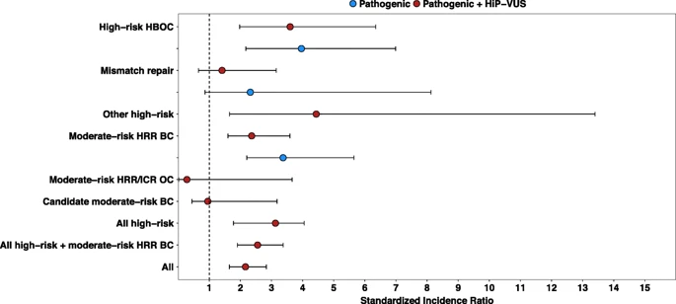
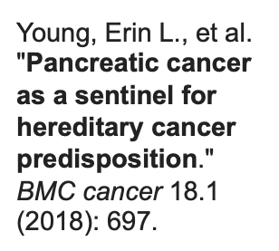
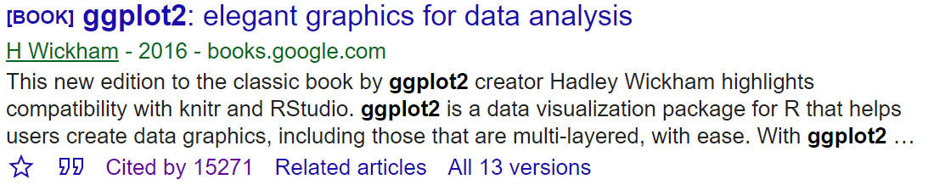
Notes:
Pancreatic cancer as a sentinel for hereditary cancer predisposition meta-analysis (Standardized incidence ratios for cancer susceptibility gene groups in unselected pancreatic cancer cases. )
2. Google scholar citation Frequently used
1 minute

Slide 5
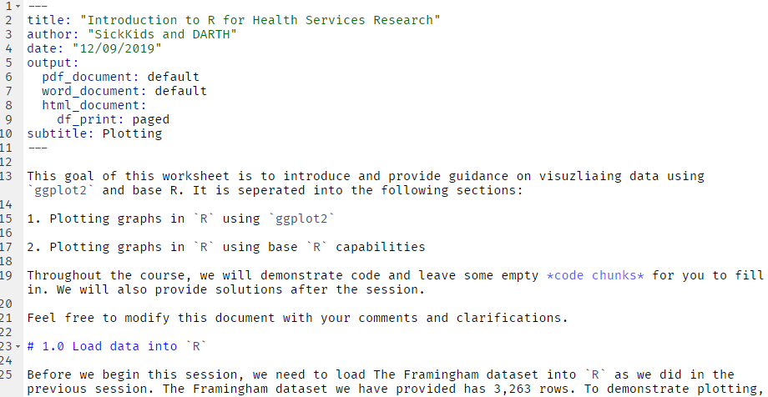
Getting Started
Install: install.packages("ggplot2”)
Load: library(ggplot2)
We will use ‘04_plotting_template.Rmd’

Slide 6
Structure of ggplot graphs
ggplot(): tells R what data will be plotted.
aes(): specifies how the data ‘maps’ to the graph. e.g.,
  which variable is on the x-axis, which on the y-axis, color depends on a variable
geom_... : what graph type are you plotting. (geom_point, geom_histogram, geom_line, etc.).

Slide 7
Data to be plotted
How the graph depends on the data
ggplot( data ,
aes( x = Age , y = BMI)) +
geom_point(color = “blue”)
graph characteristics that don’t depend on data
type of graph

Slide 8
Data to be plotted
How the graph depends on the data
ggplot(data) +
geom_point( aes( x = Age , y = BMI), color = “blue”)
type of graph
graph characteristics that don’t depend on data

Slide 9

ggplot( )

Slide 10
ggplot(data)

Slide 11
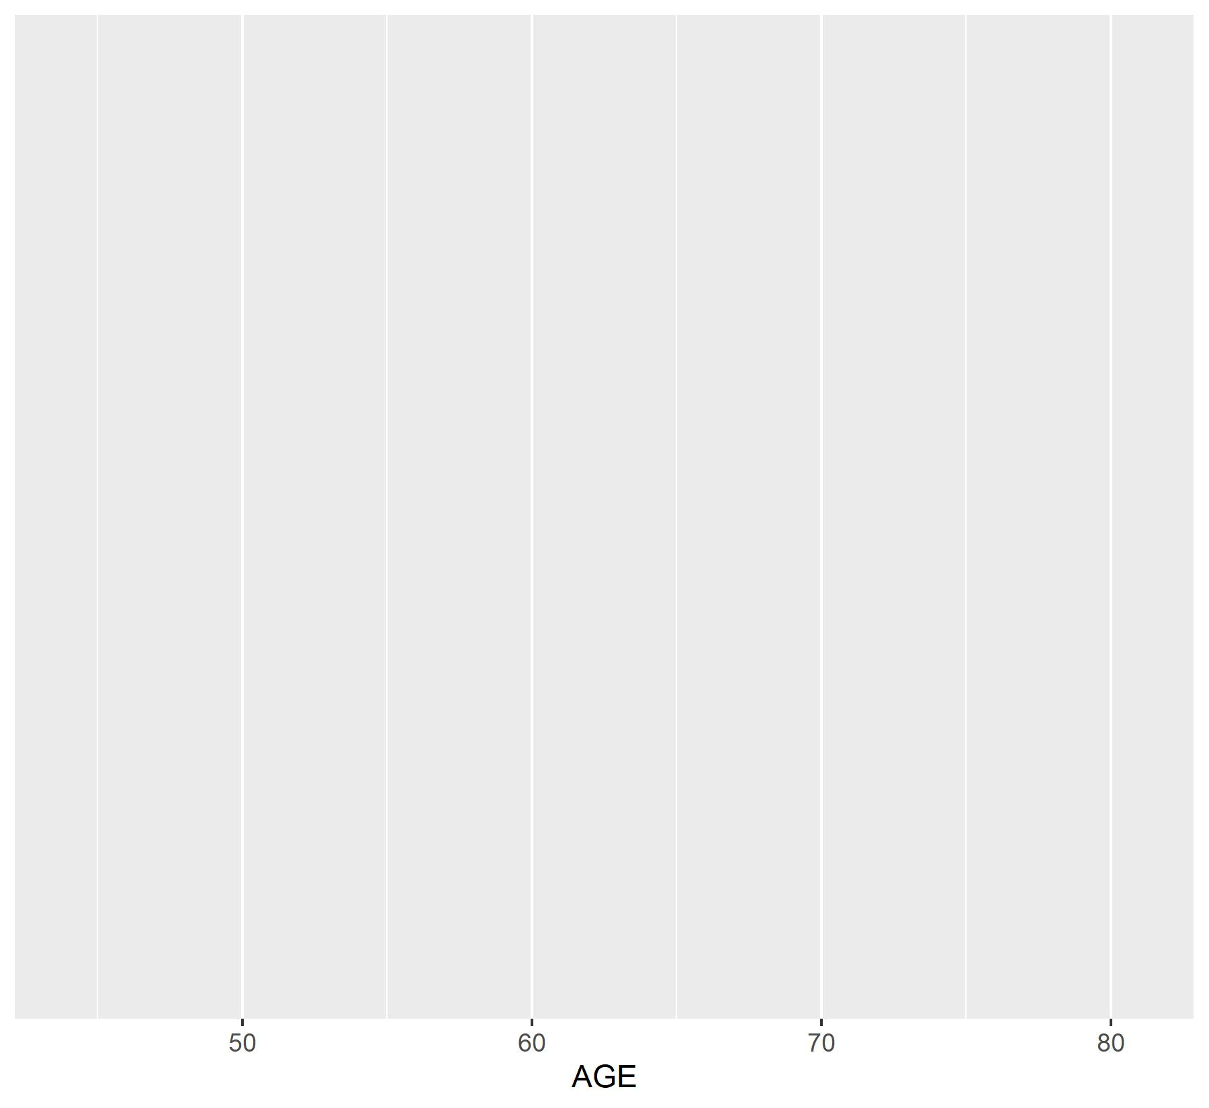
ggplot(data,
aes(x = AGE))

Slide 12
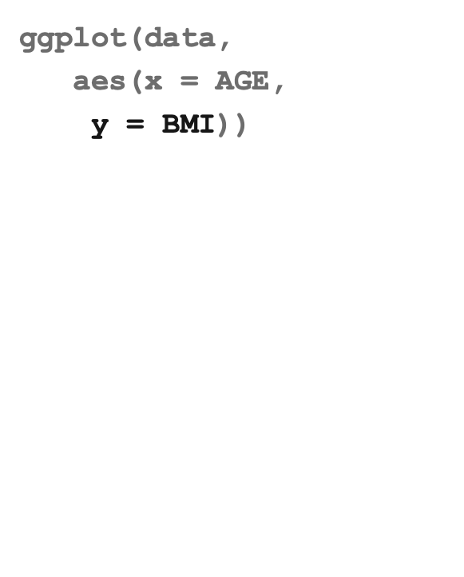
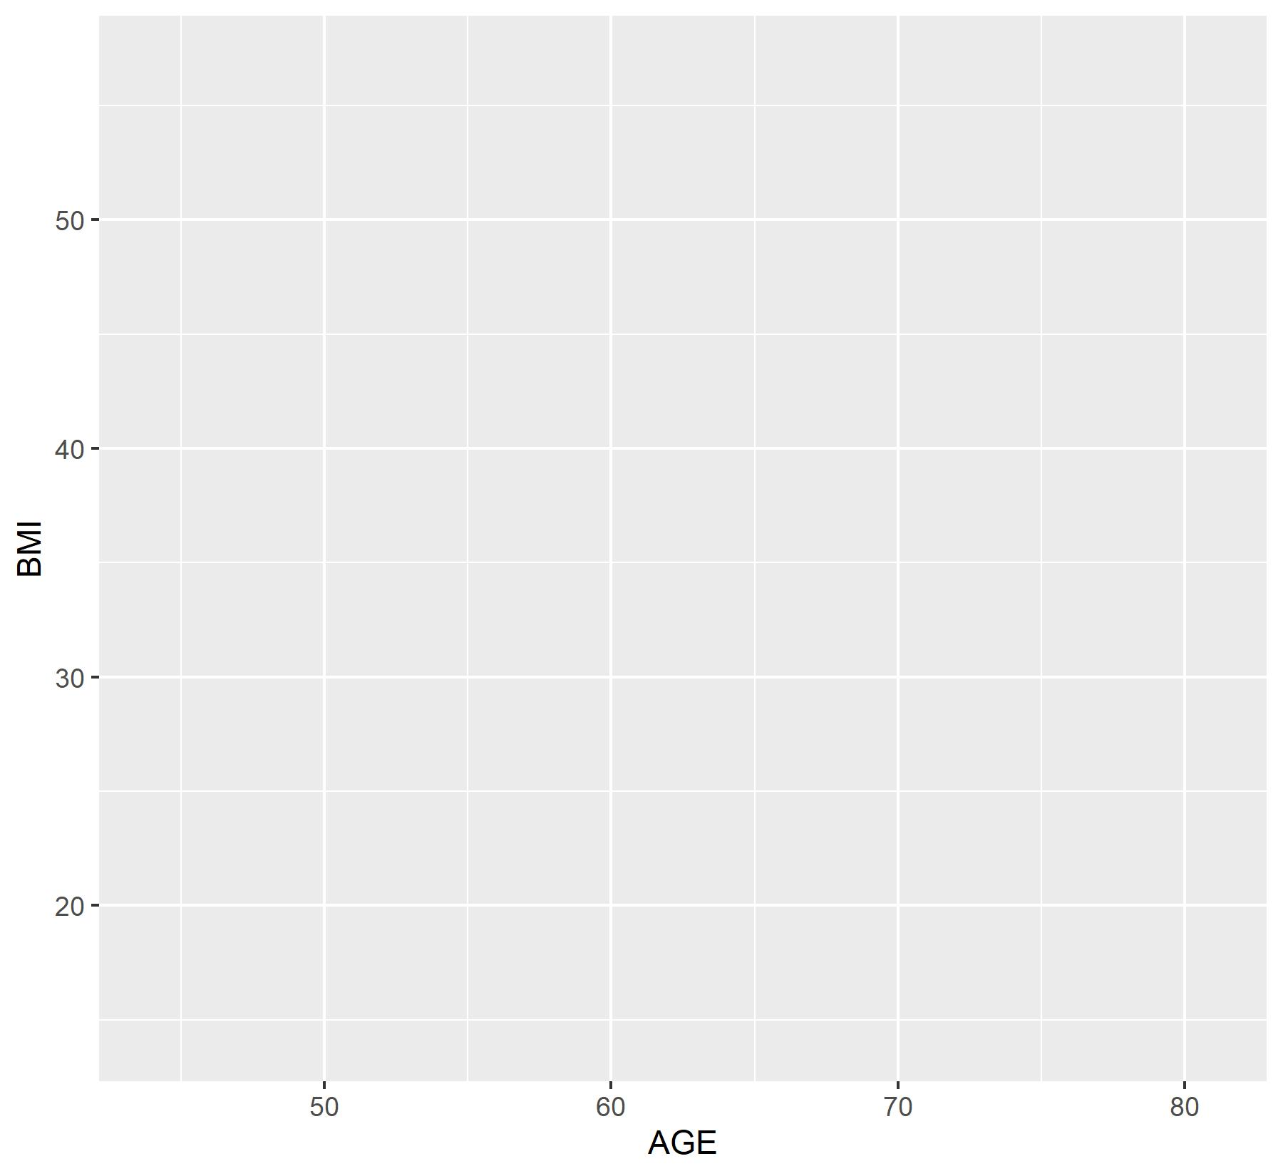

Slide 13
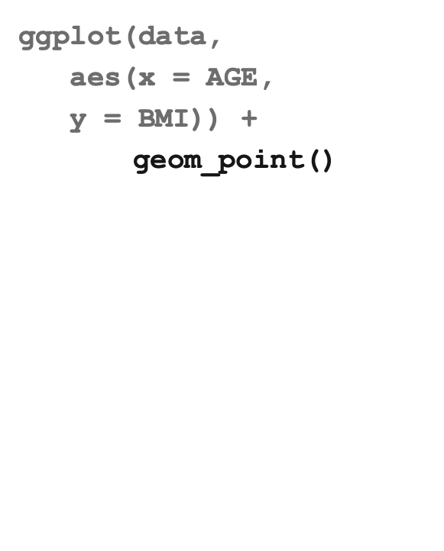
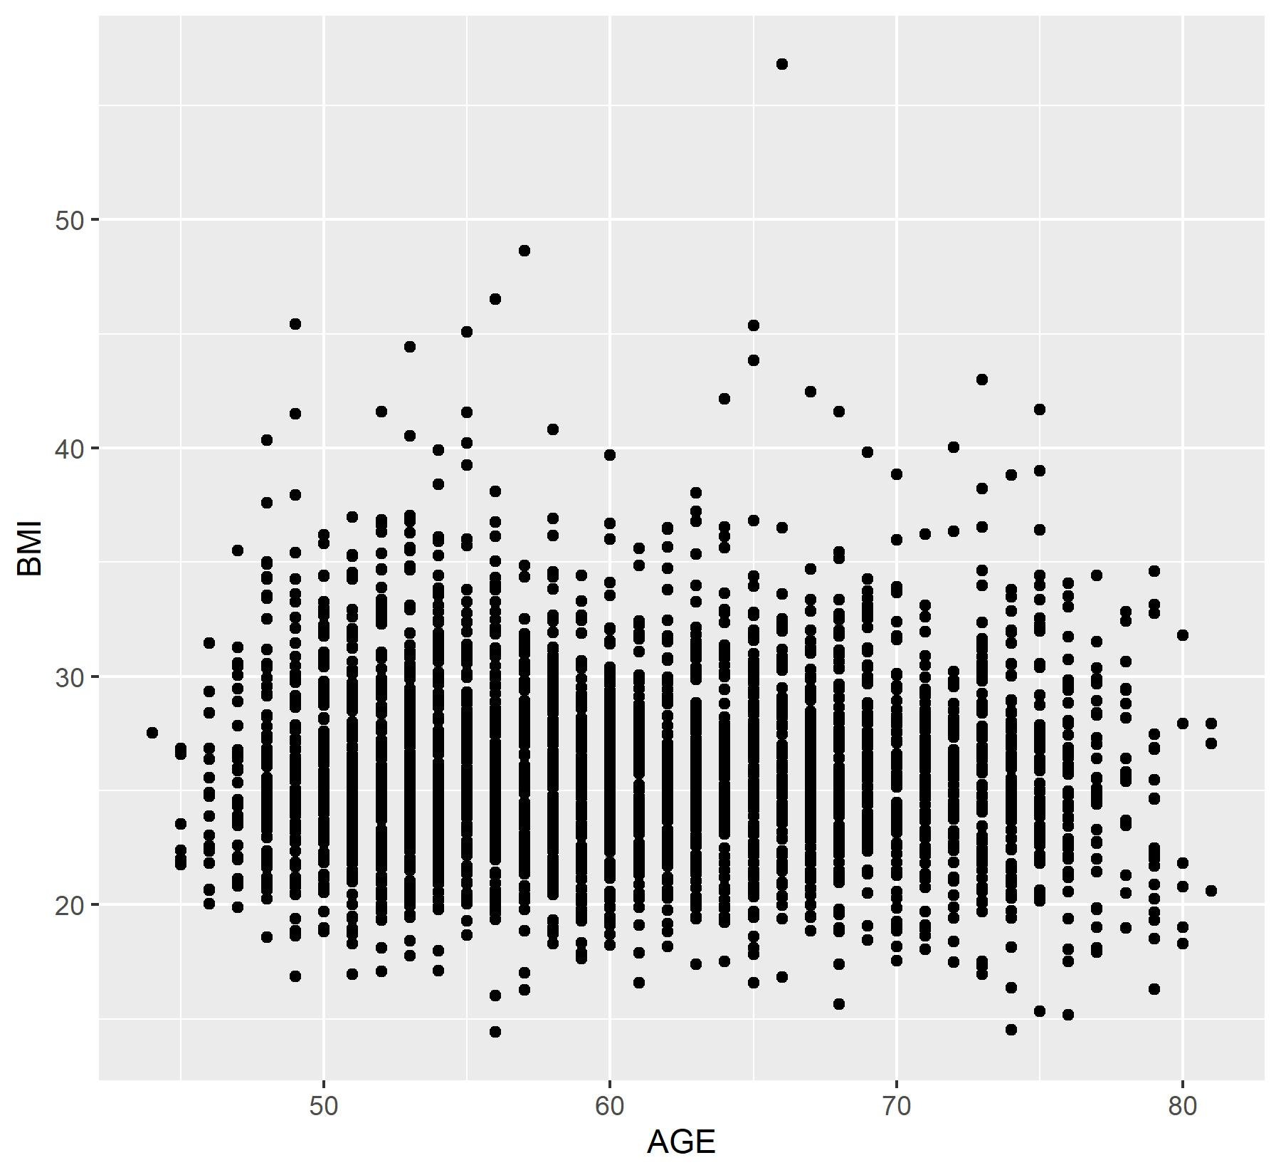

Slide 14
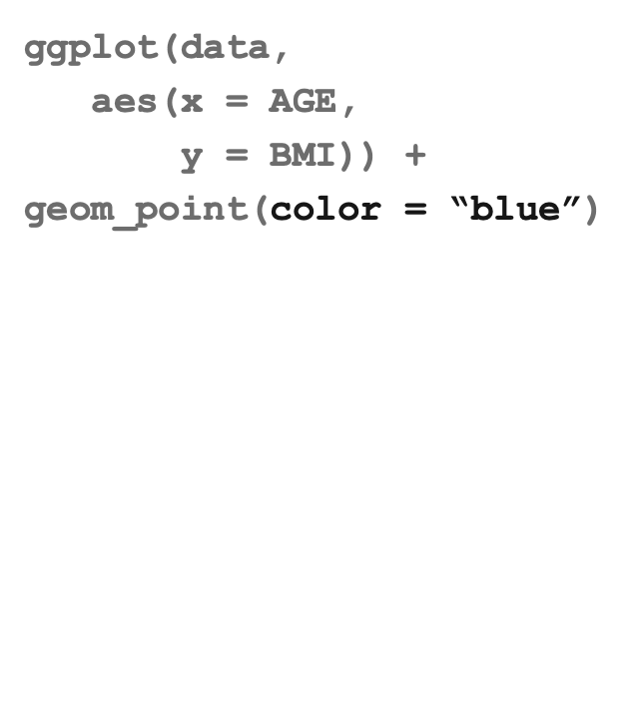
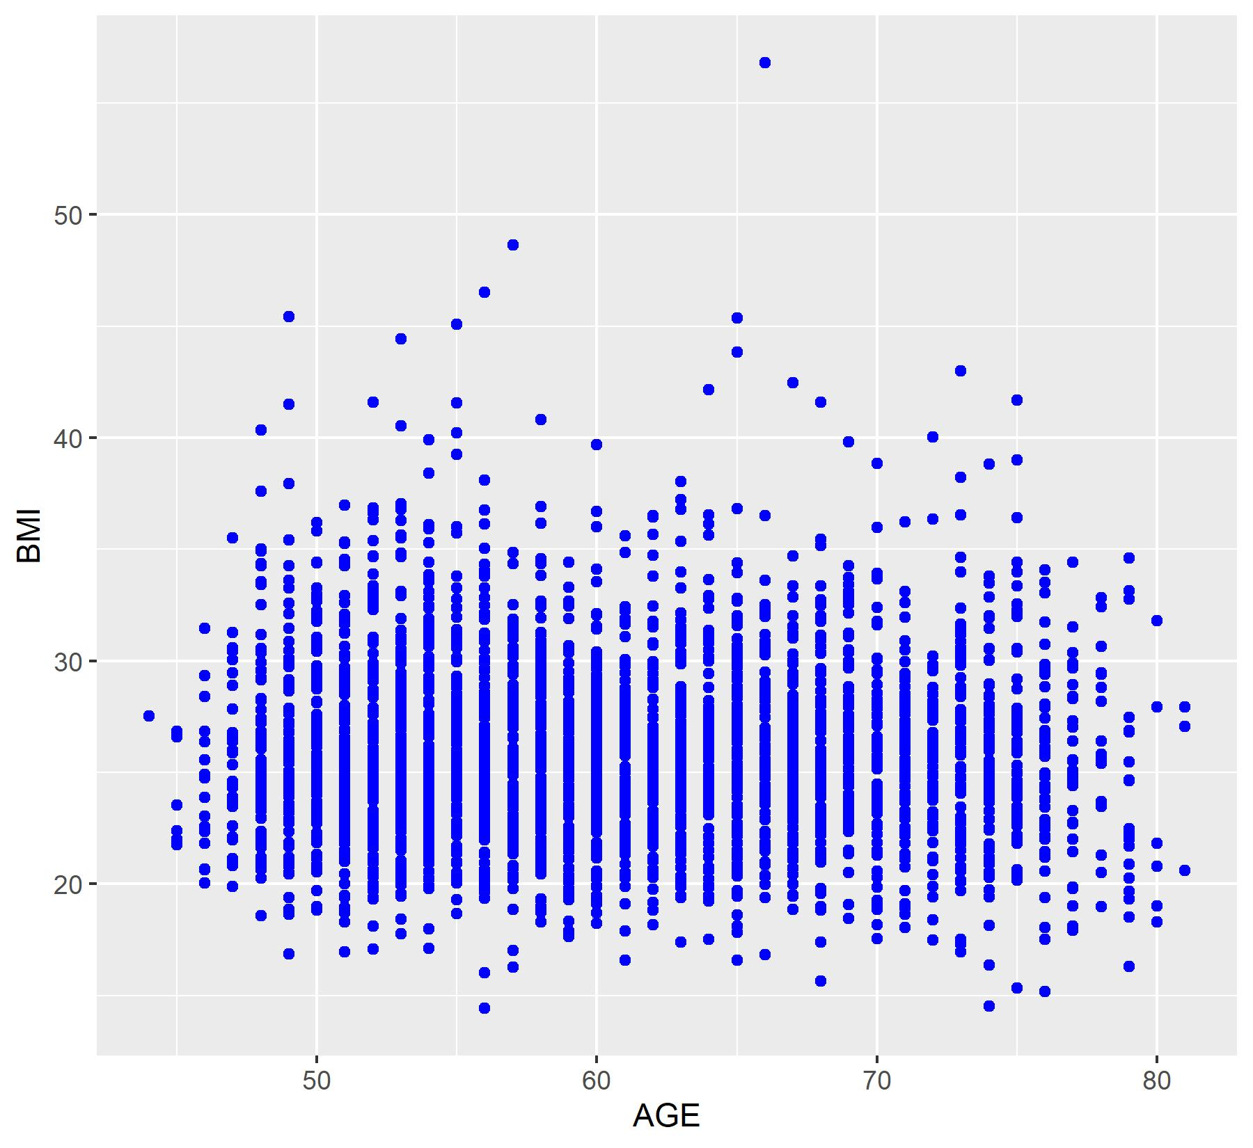

Slide 15
Aesthetics
Each geom_ function has a custom set of aesthetics you can modify. For geom_point() these include
x: variable on the x-axis.
y: variable on the y-axis.
colour: modifies colour of points
alpha: transparency
shape
size
You can use the ? function to view aesthetics for each type of graph.
?geom_point()

Slide 16
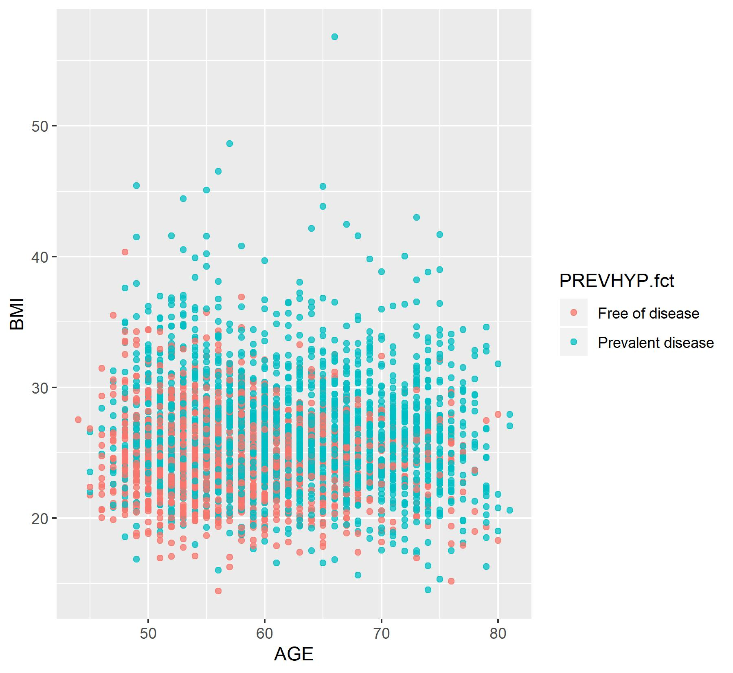
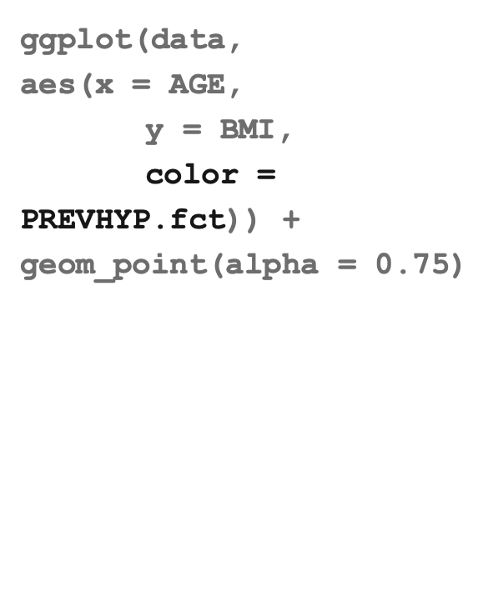

Slide 17
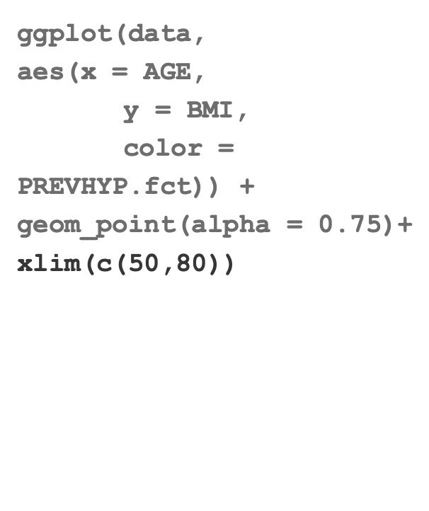
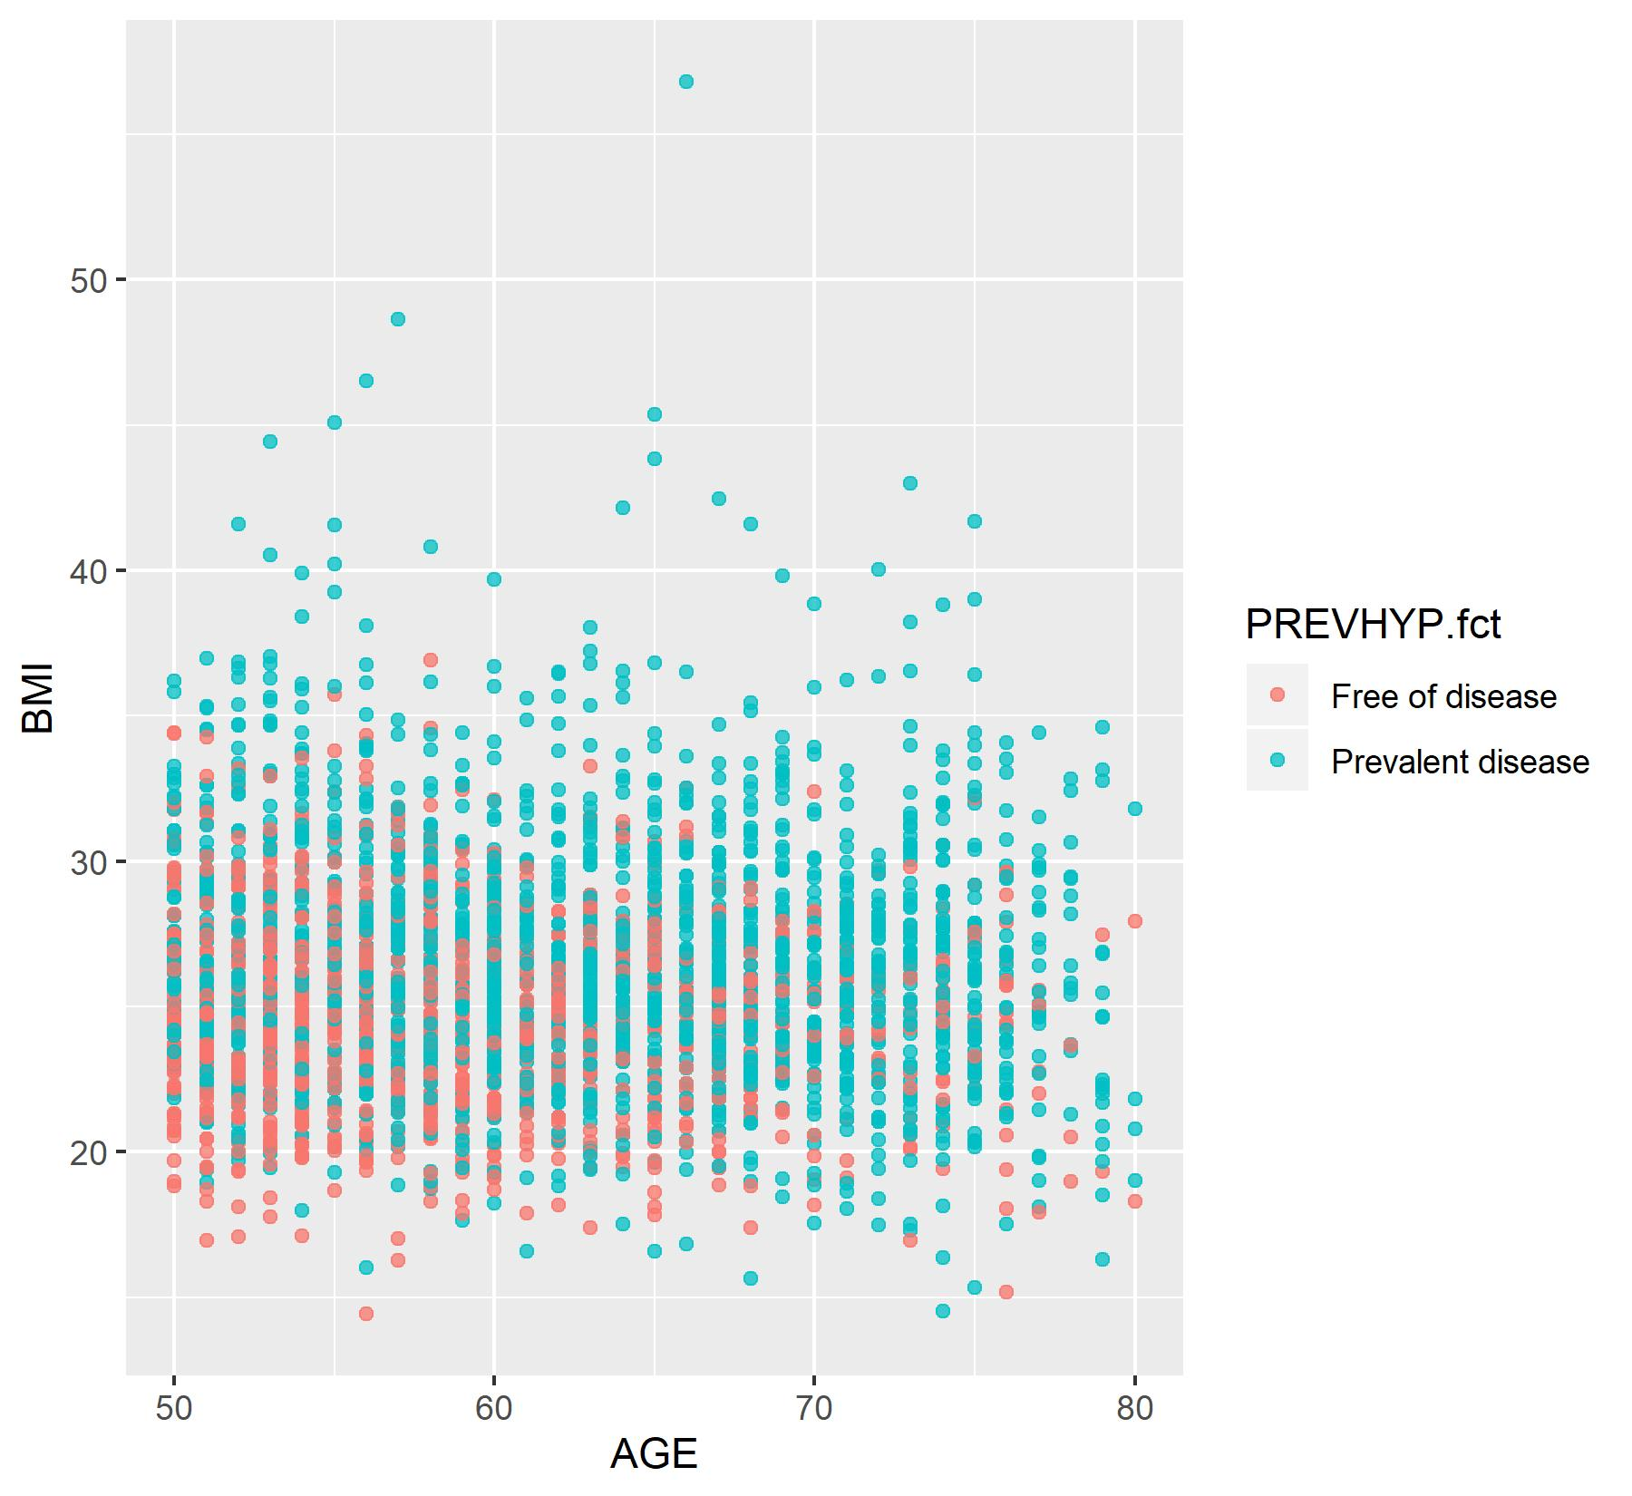

Slide 18
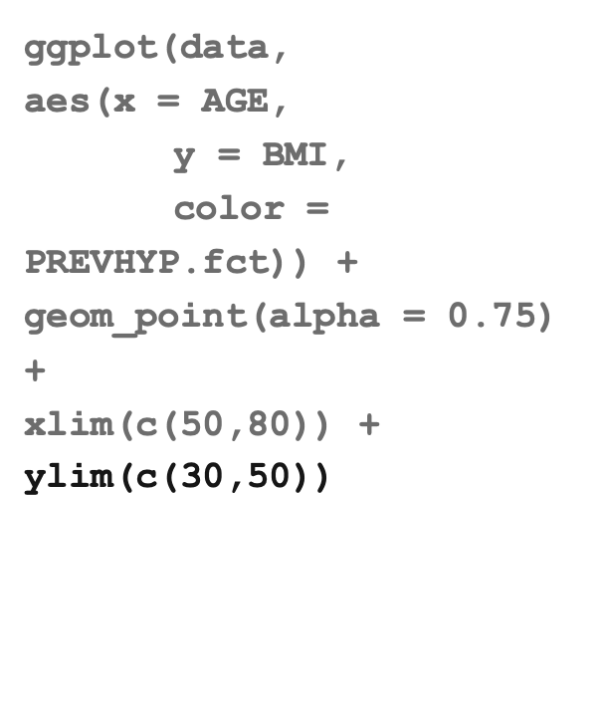
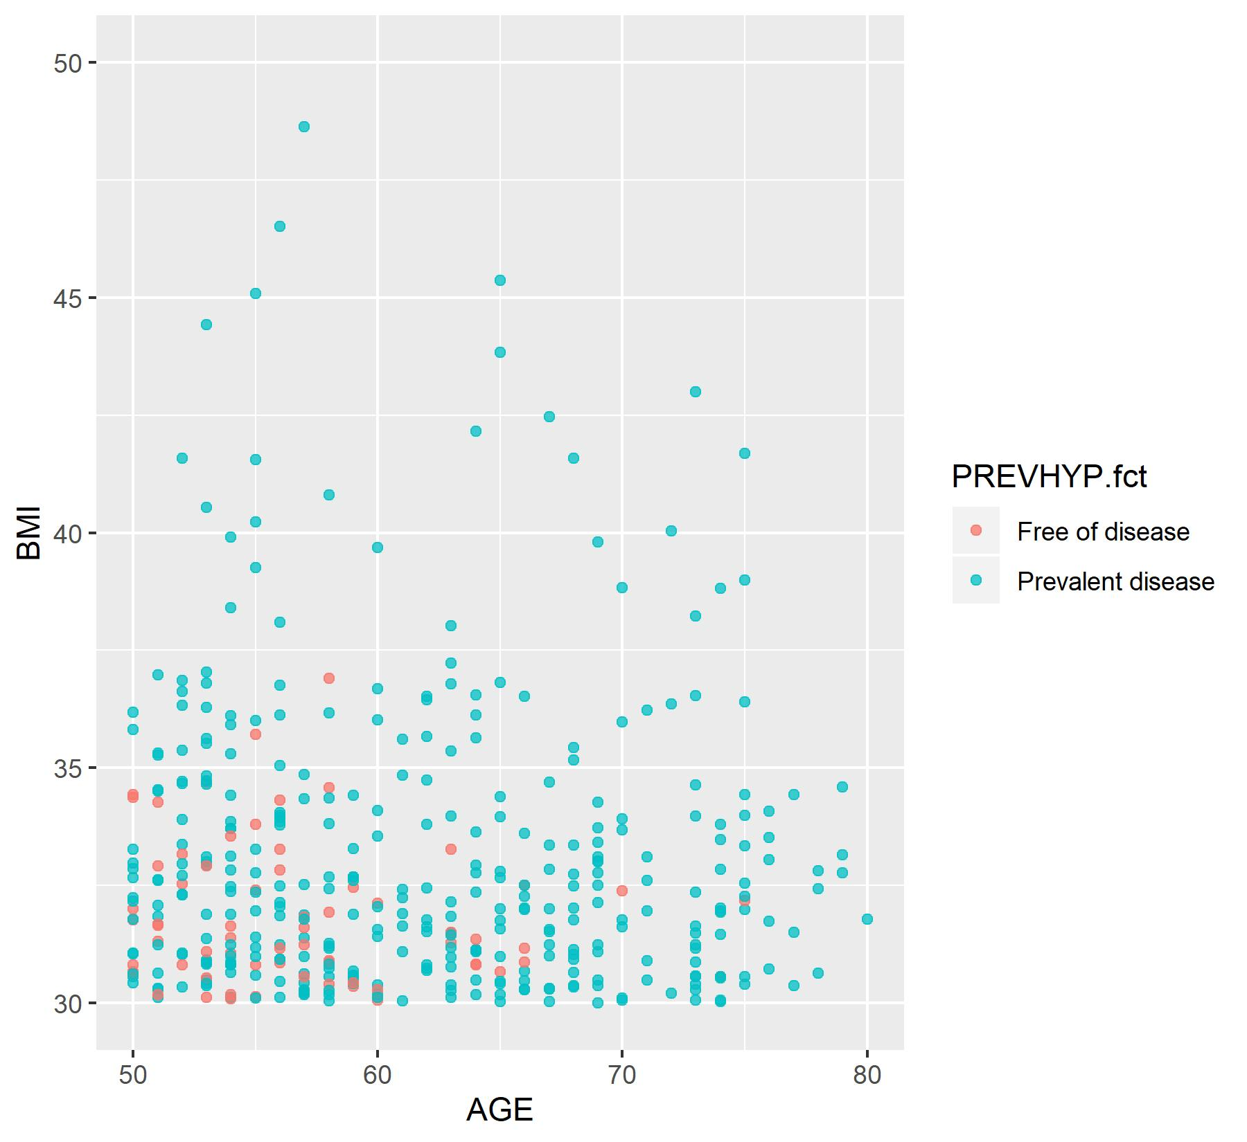

Slide 19
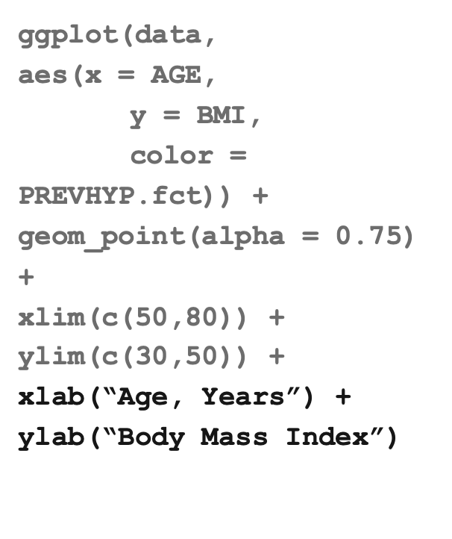

Slide 20
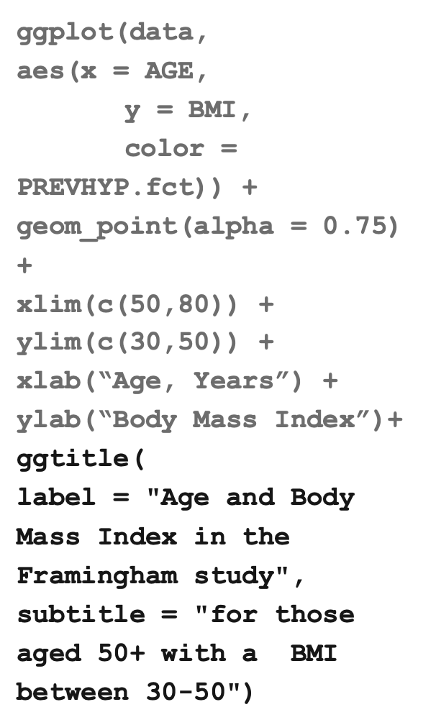
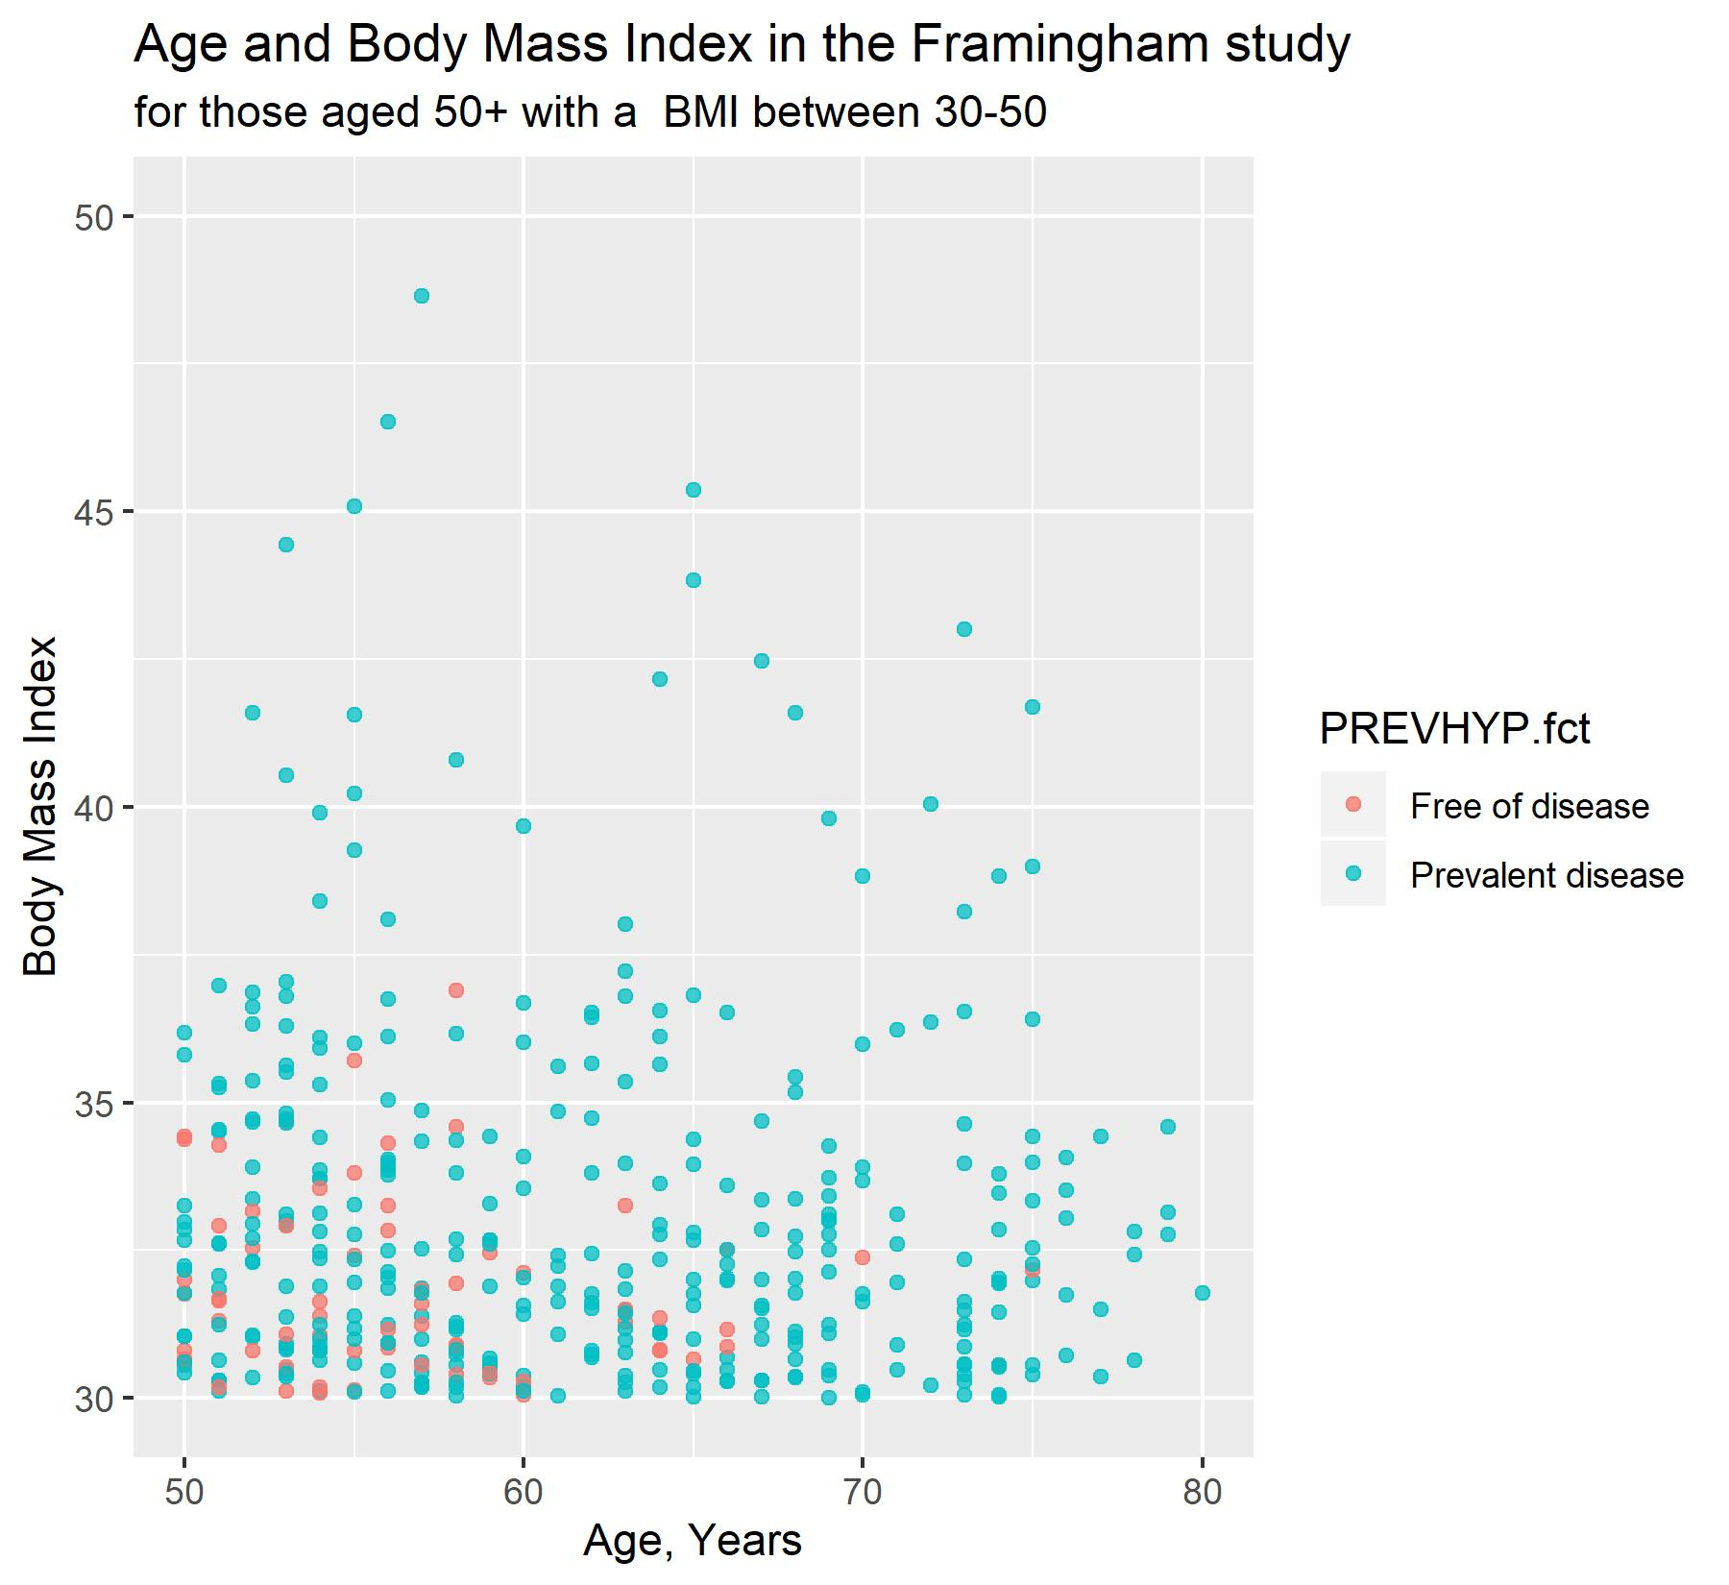

Slide 21
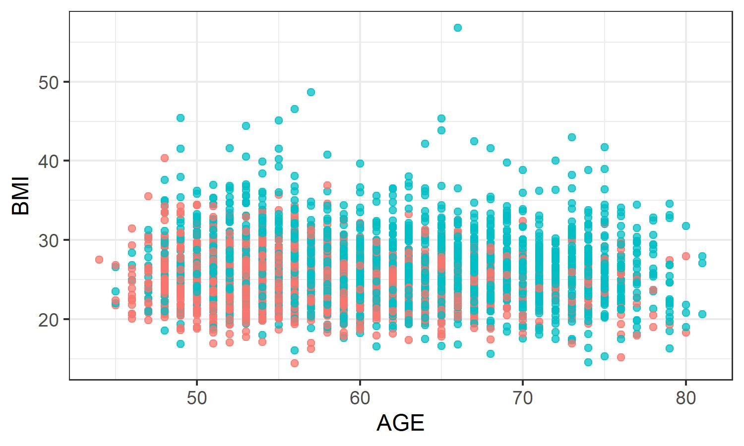

Themes
Themes are pre-existing templates that change how a ggplot2 graph is displayed. The ggthemes package provides a larger number of community created themes.
+ theme_bw()
+ theme_linedraw()

Slide 22
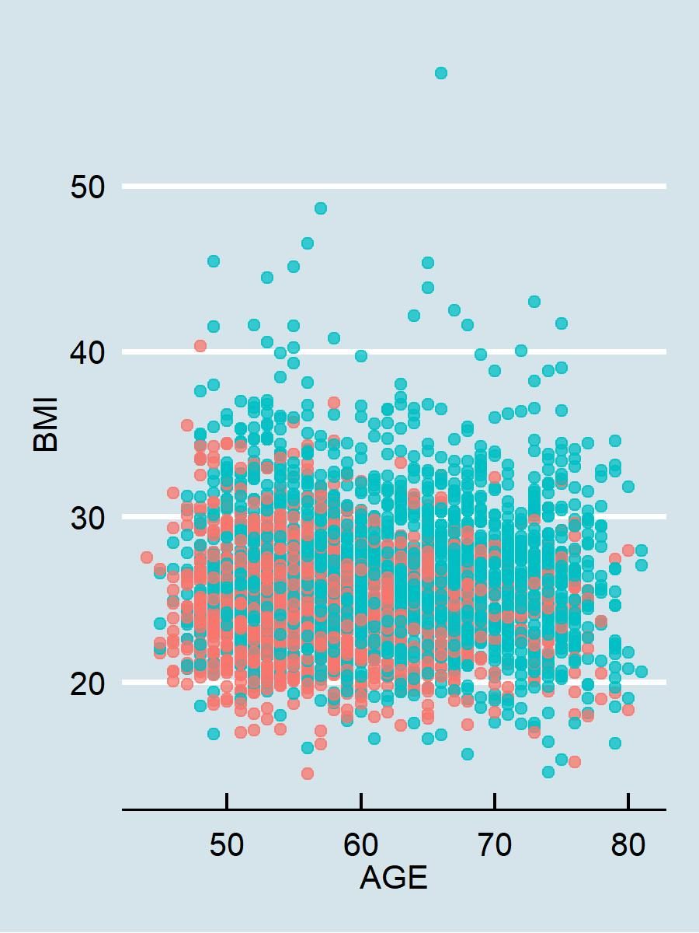
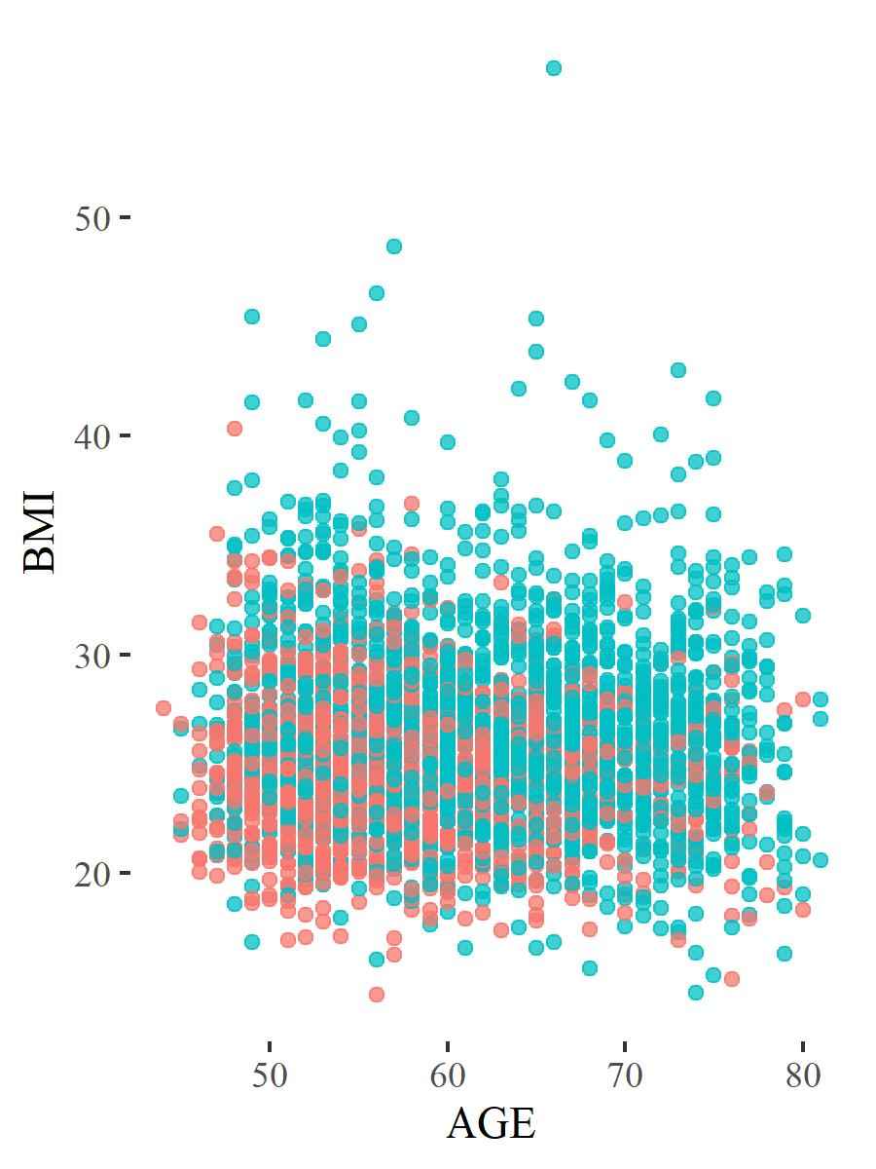
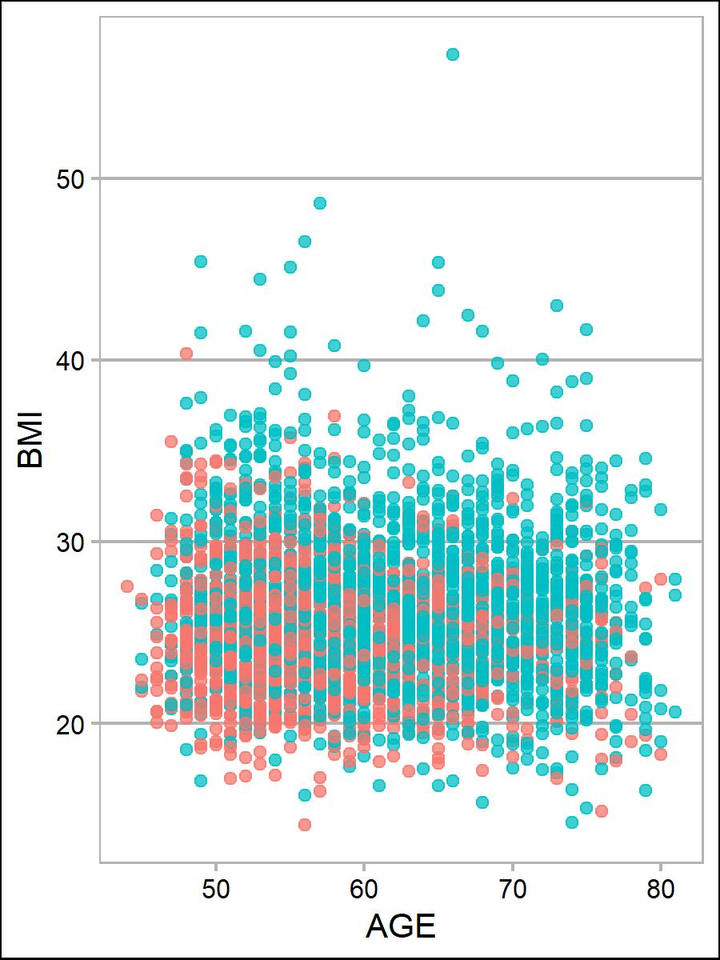
ggtheme examples
+ theme_economist()
+ theme_tuft()
+ theme_calc()

Slide 23
Other graphs
Making other types of graphs in ggplot2 follows a similar structure as scatterplots for geom_point. All that’s required is modifying geom_… and associated aes().
geom_histogram
geom_line: line plots
geom_density: density
geom_bar: bar charts
geom_boxplot: box and whisker plot
geom_step: step wise plot
...

Slide 24
Tricky ggplot2 concepts (faceting and groups)
faceting: spreading a single plot into multiple panels
groups: trying to plot multiple plots into a single panel

Slide 25
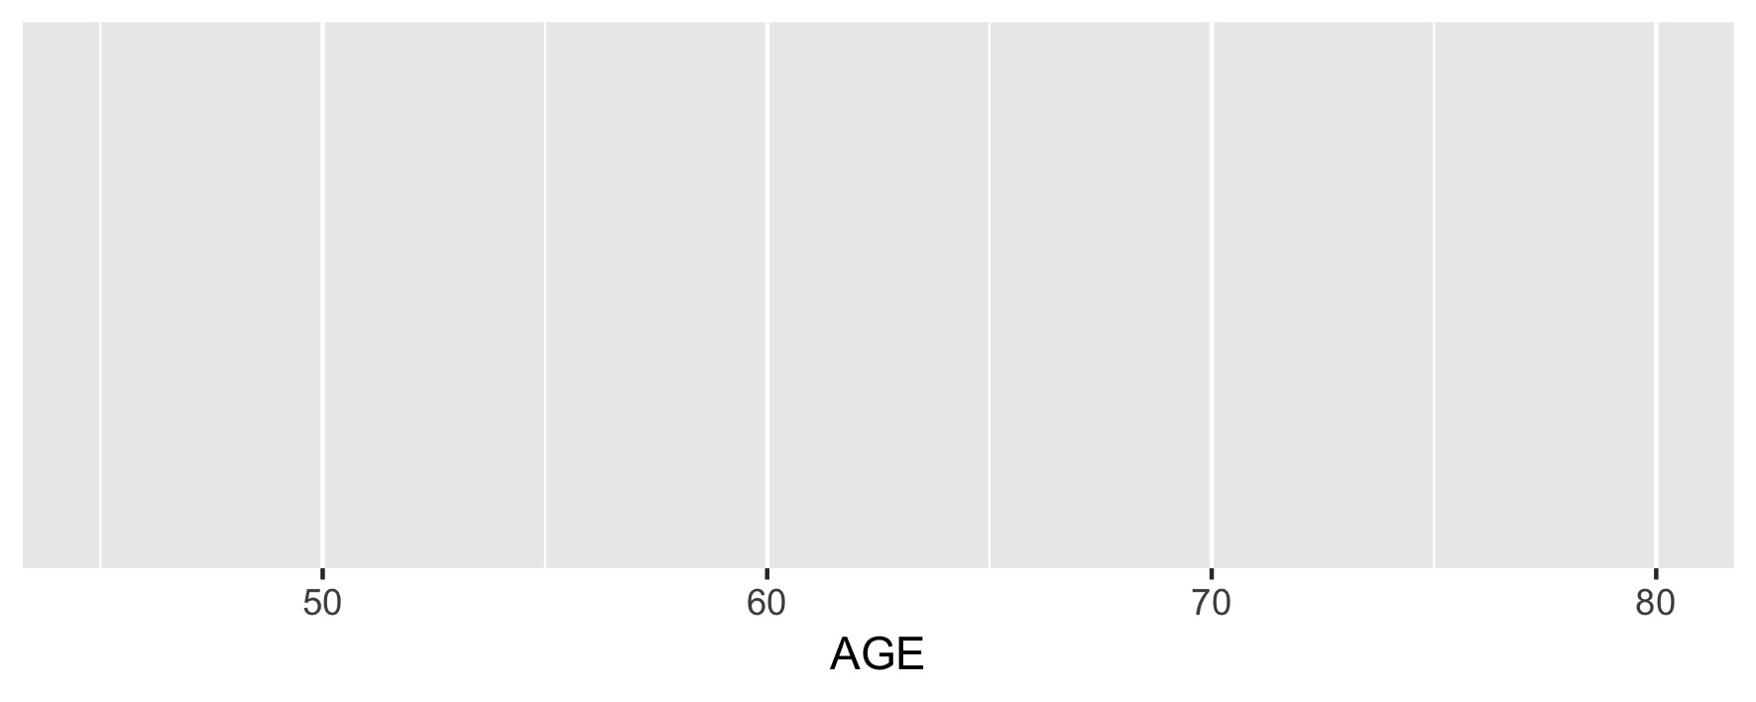
ggplot(data,
aes(x = AGE))

Slide 26
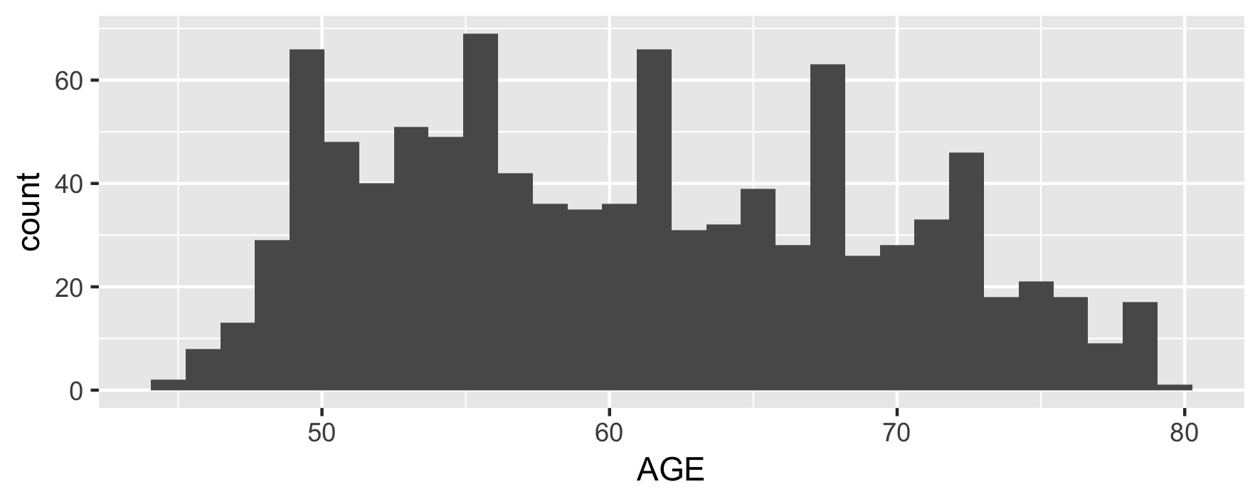
ggplot(data,
aes(x = AGE)) +
geom_histogram()

Slide 27
ggplot(data,
aes(x = AGE, fill = educ)) +
geom_histogram()

Slide 28
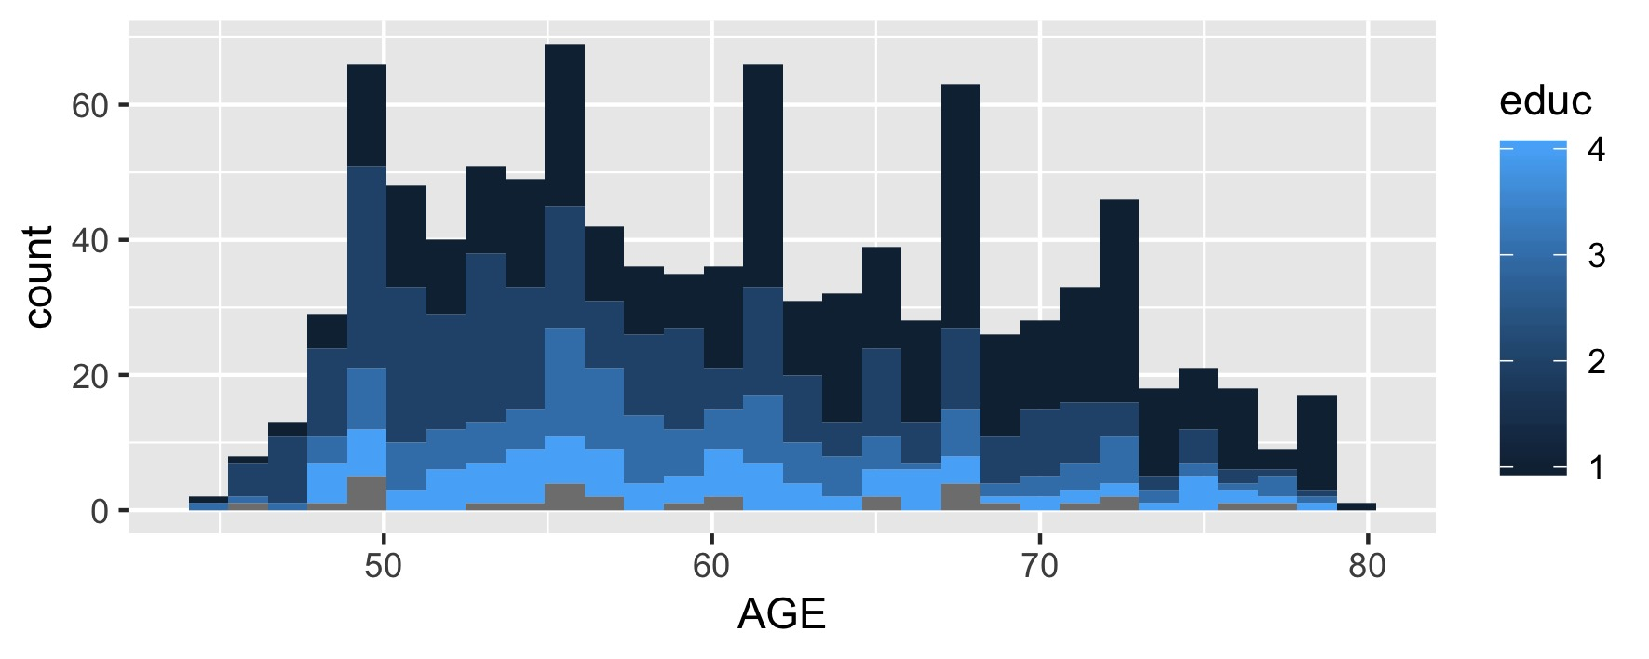
ggplot(data,
aes(x = AGE, fill = educ,
group = educ)) +
geom_histogram()

Slide 29
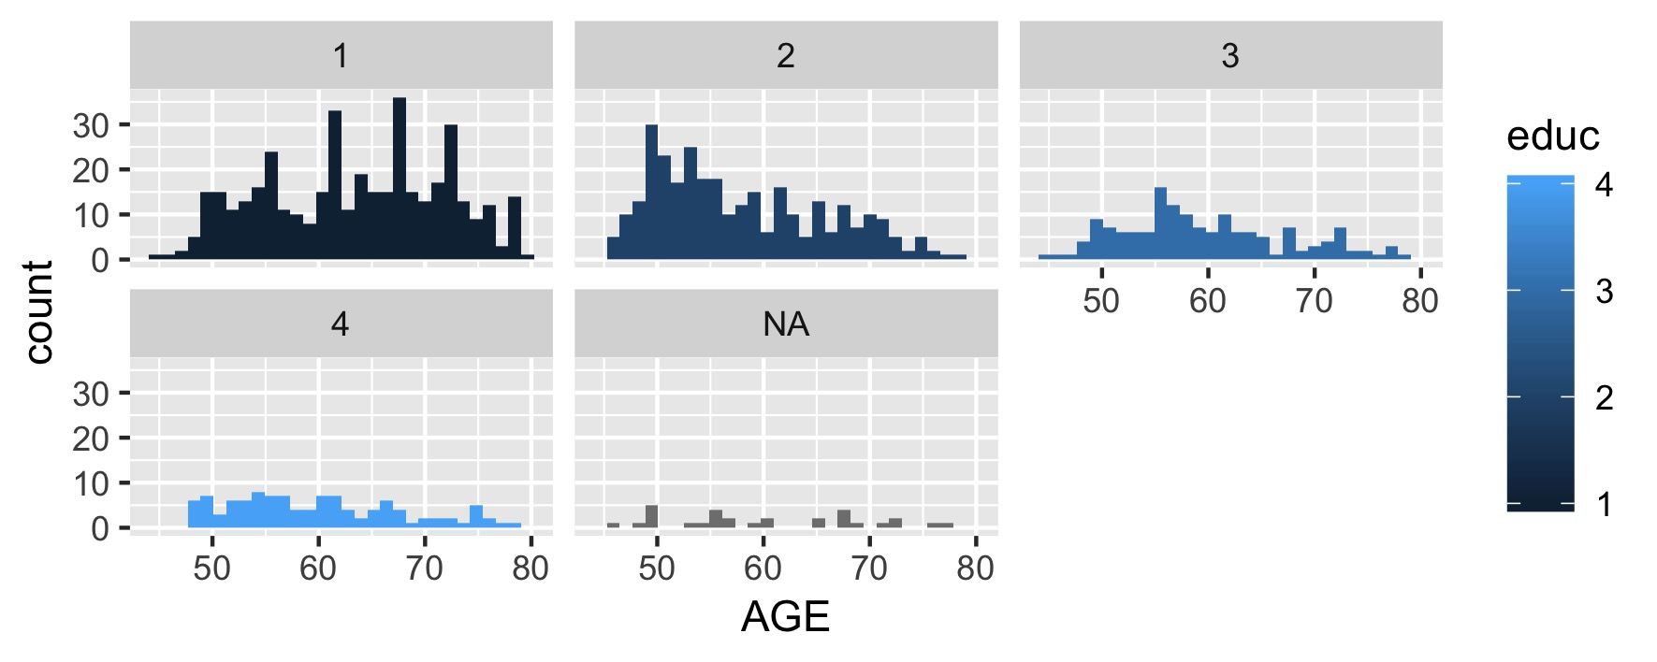
ggplot(data,
aes(x = AGE, fill = educ)) +
geom_histogram() +
facet_wrap(~educ)

Slide 30
Objectives
Using ggplot2 to create data visualization in R.
Using base R to quickly explore data in R.

Slide 31
Why base R plotting?
Quickly exploring data.
Pre-specified plotting of output of functions

Slide 32
Structure of base R plots
Base R plots vary by the type of plot we want to create.
Common plotting functions:
plot() - general plotting includes scatterplots
hist() – Histograms
boxplot() – box and whisker plots

Slide 33
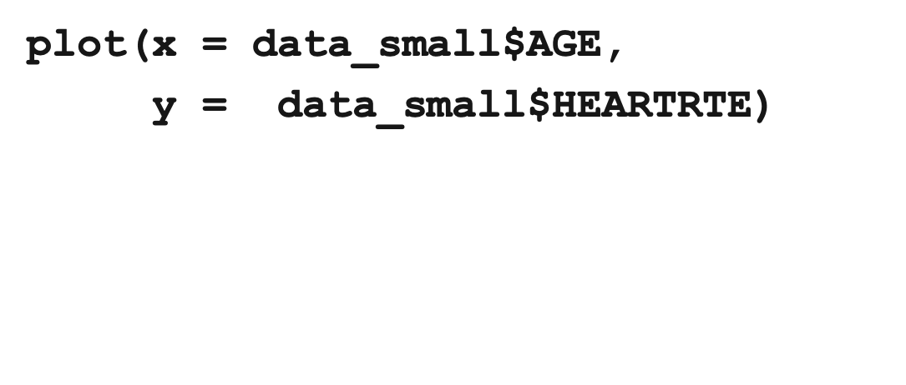
Scatterplots
Have to select the
correct column from
your data

Slide 34
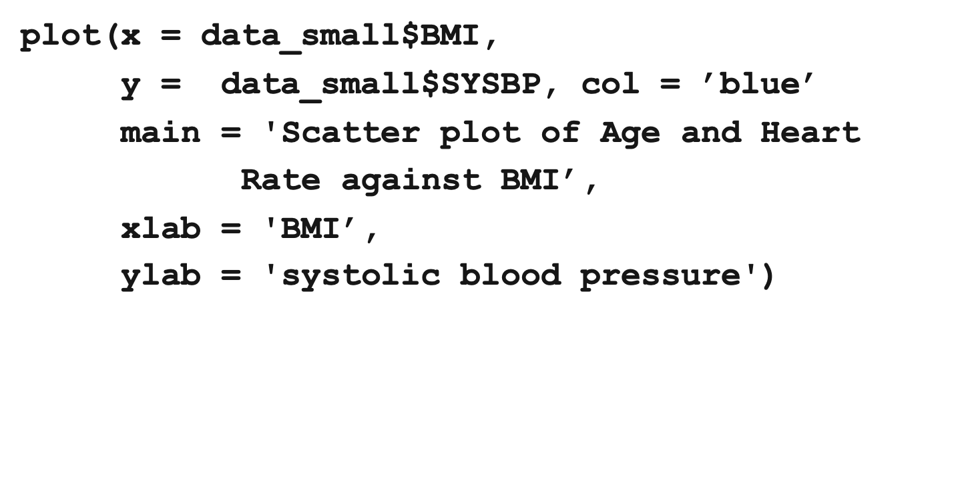
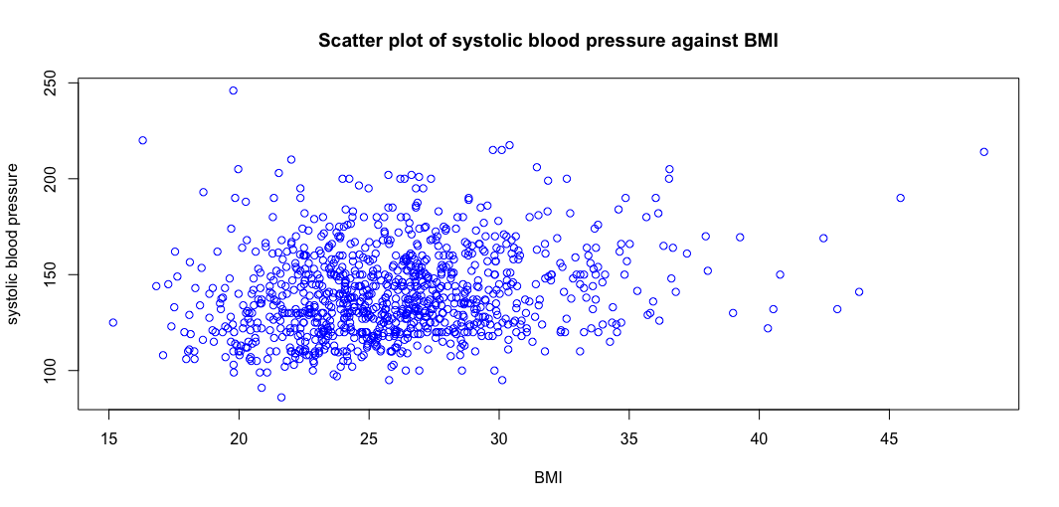

Slide 35
Plotting output of functions
Some R functions have output which can be visualized using the plot function.
Linear models for regression diagnostics, c.f., tomorrow
The density function
Survival models

Slide 36
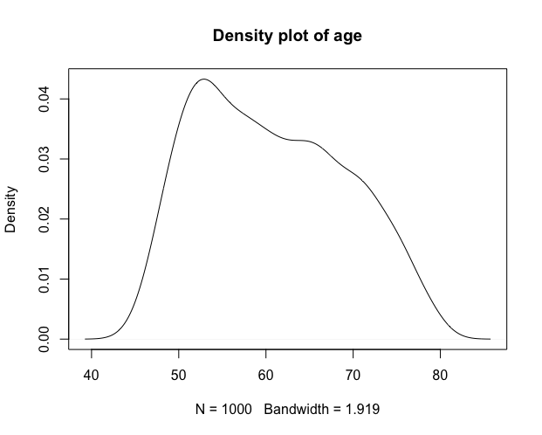
den.age <- density(data$AGE)
plot(den.age)
den.age
class(den.age)
> ”density”

